Slide 1
Introduction to Advanced Phishing Awareness Training
A comprehensive guide for Advanced IT Security Analysts
PRESENTED BY
Patel Mahi Parimal
GSFC University

Slide 2
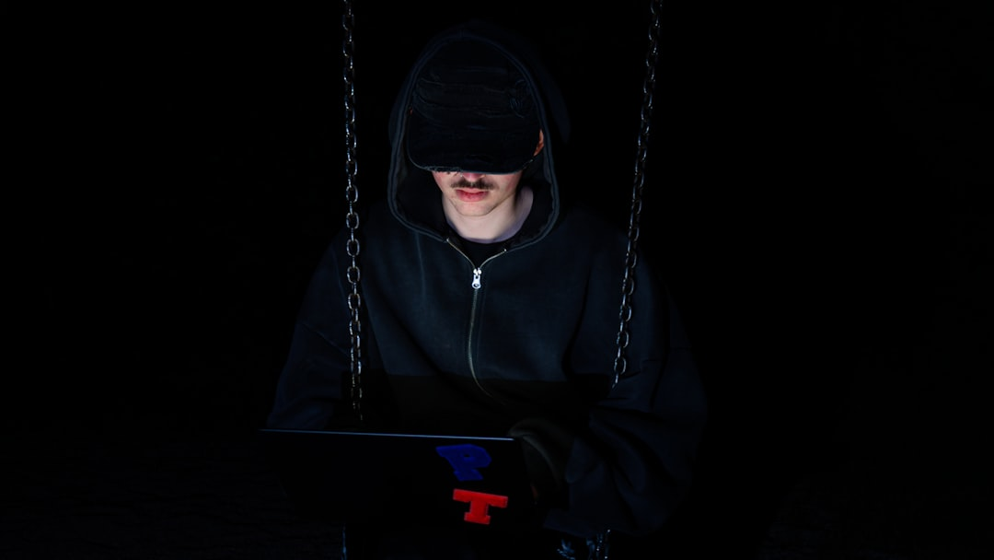
Introduction to Advanced Phishing Awareness Training
In today's digital landscape, phishing attacks have evolved, targeting even the most vigilant users. This training module will equip IT security analysts with the knowledge to identify sophisticated phishing emails and counterfeit websites. By understanding social engineering tactics and recognizing red flags, analysts can better protect their organizations. Real-world examples and interactive quizzes will enhance engagement and retention, ensuring that participants can apply best practices effectively to mitigate risks associated with phishing threats.

Slide 3
Understanding Phishing Attacks
1
Exploitation of Human Psychology
Phishing attacks manipulate human emotions, such as fear and urgency, leading to data breaches. Attackers often craft messages that appear legitimate, increasing the likelihood of user compliance.
2
Prevalence of Phishing Attempts
In 2022, 83% of organizations reported experiencing phishing attempts, highlighting the widespread nature of this threat. This statistic underscores the need for robust training and awareness programs.
3
Consequences of Phishing
Phishing can result in significant financial losses, reputational damage, and regulatory penalties. Organizations must recognize these risks to prioritize effective security measures and employee training.
4
4
Evolution of Phishing Tactics
Phishing tactics have evolved, incorporating advanced social engineering techniques. Understanding these changes is essential for developing effective defenses and enhancing organizational resilience against attacks.

Slide 4


Recognizing Phishing Emails
GENERIC GREETINGS
Phishing emails often use generic greetings like 'Dear Customer.' Legitimate organizations personalize emails, addressing you by name, which is a key indicator of authenticity.
SPELLING ERRORS
Many phishing emails contain spelling and grammatical errors. A 2022 study found that 70% of phishing attempts had noticeable mistakes, signaling potential fraud.
HOVERING OVER LINKS
Always hover over links to reveal the actual URL. Phishing links often disguise their true destination, leading to malicious sites that can compromise your data.
URGENT LANGUAGE
Phishing attempts frequently use urgent language or threats to provoke hasty actions. Be cautious of emails that pressure you to act quickly, as they may be fraudulent.

Slide 5

Identifying Fake Websites
1
Verify the URL
Phishing sites often use misspelled or similar domain names. For instance, 'paypa1.com' instead of 'paypal.com' can easily deceive users. Always double-check the URL before entering sensitive information.
2
Check for HTTPS
Look for HTTPS and a padlock icon in the address bar. A lack of these indicators may suggest a fraudulent site. In 2022, 80% of phishing sites lacked proper SSL certificates.
3
Assess Branding Consistency
Check for inconsistencies in branding and design. Legitimate websites maintain a consistent aesthetic. For example, mismatched logos or color schemes can indicate a scam.
4
Use WHOIS Tools
Utilize WHOIS to verify domain registration details. Many phishing domains are registered anonymously or for short durations, which can signal potential fraud.

Slide 6
Social Engineering Tactics
1
Pretexting Techniques
2
Baiting Strategies
3
Tailgating Risks
Pretexting involves creating a believable scenario to manipulate individuals into divulging confidential information, often leveraging personal data to enhance credibility and trust.
Baiting entices victims with promises of free items or services, leading them to malicious sites or downloads that compromise sensitive data, exemplified by fake software offers.
Tailgating occurs when unauthorized individuals gain physical access to secure areas by following authorized personnel, exploiting social norms of politeness and trust in shared spaces.

Slide 7
Best Practices to Avoid Phishing
✓
Implement Multi-Factor Authentication
Utilize MFA to enhance security. Studies show that MFA can block 99.9% of automated attacks, significantly reducing the risk of unauthorized access to sensitive information.
✓
Regular Software Updates
Keep all systems updated to patch vulnerabilities. In 2022, 60% of breaches exploited unpatched software, highlighting the importance of timely updates in maintaining security.
✓
Conduct Phishing Simulations
Regularly test employees with phishing simulations. Organizations that conduct these exercises see a 70% improvement in threat recognition, fostering a proactive security culture.
✓
Encourage a Culture of Skepticism
Promote verification before clicking links. Research indicates that 85% of successful phishing attacks stem from user error, emphasizing the need for cautious behavior online.

Slide 8
Real-World Phishing Examples
TARGET'S 2013 BREACH
In 2013, Target suffered a massive data breach affecting 40 million credit card accounts, initiated by a phishing email that compromised vendor credentials, highlighting the risks of third-party access.
GOOGLE AND FACEBOOK SCAM
Between 2013 and 2015, a Lithuanian hacker scammed Google and Facebook out of $100 million through phishing emails, showcasing the financial impact of sophisticated phishing schemes.
2020 TWITTER HACK
The 2020 Twitter hack exploited social engineering tactics, where attackers gained access to high-profile accounts by tricking employees into revealing credentials, emphasizing the importance of employee training.
COLONIAL PIPELINE ATTACK
The 2021 Colonial Pipeline ransomware attack was linked to a phishing incident, demonstrating how phishing can lead to significant operational disruptions and national security concerns.

Slide 9
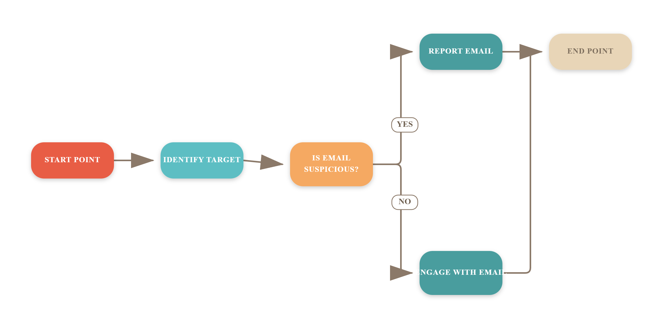
Phishing Attack Lifecycle

Slide 10
How to Respond to Phishing Attempts
1. Do Not Click Links or Download Attachments
If you suspect an email is a phishing attempt, avoid clicking on any links or downloading attachments to prevent malware installation.
2. Report to IT Security Team
Immediately forward the phishing email to your IT security team for investigation and to help protect others in the organization.
3. Delete the Email
After reporting, delete the email from your inbox and empty your trash to ensure it cannot be accessed later.
4. Monitor Your Accounts
Regularly check your accounts for any suspicious activity, such as unauthorized transactions or changes to your personal information.

Slide 11
The Alarming Impact of Phishing Attacks
90%
220%
$1.6M
Data Breaches
Increase in Phishing Attacks
Average Cost
Over 90% of data breaches are caused by phishing attacks.
Phishing attacks surged by 220% in 2021 compared to 2020.
The average cost of a phishing attack for a business is $1.6 million.

Slide 12
Frequently Asked Questions
Q: What should I do if I clicked a phishing link?
A: Disconnect from the internet immediately and report the incident to IT to mitigate any potential damage.
Q: Can phishing attacks be prevented?
A: Yes, phishing attacks can be significantly reduced through regular training, increased awareness, and implementing robust security measures.
Q: How often should phishing training be conducted?
A: Phishing training should be conducted at least quarterly to ensure ongoing awareness and preparedness among employees.
Q: What are some signs of a phishing email?
A: Look for generic greetings, urgent language, suspicious links, and unexpected attachments as common indicators of phishing attempts.

Slide 13
"Phishing is the gateway to many cyber attacks; awareness is the first line of defense."
— Cybersecurity Expert
This quote emphasizes the critical role of awareness in preventing phishing attacks and safeguarding sensitive information.

Slide 14
Phishing vs. Spear Phishing
General Phishing
Spear Phishing
• Broad attacks targeting a large number of users.
• Targeted attacks aimed at specific individuals or organizations.
• Often uses generic messages to lure victims.
• Personalized messages that appear legitimate to the victim.
• Commonly distributed via email, social media, or messaging apps.
• Often involves research on the target to increase credibility.
• Relies on mass appeal and urgency to prompt action.
• Can lead to significant data breaches or financial loss.
• Examples include fake lottery wins or account verifications.
• Examples include CEO fraud or targeted business emails.

Slide 15
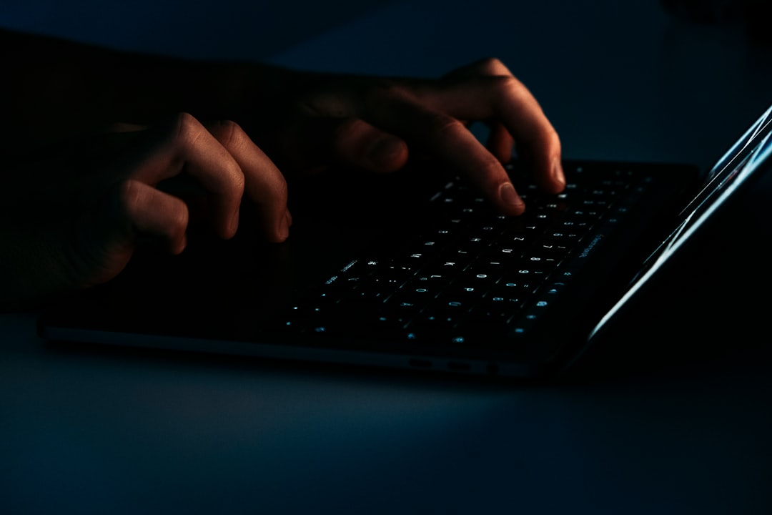
Understanding Phishing Threats
This image illustrates various phishing tactics, including email spoofing and fake websites. Key takeaway: Recognizing these threats is crucial for preventing data breaches and protecting sensitive information.

Slide 16
Key Takeaways
In conclusion, understanding phishing tactics is crucial for safeguarding sensitive information. Recognize red flags in emails and websites, and employ best practices like multi-factor authentication. Engage in continuous training to stay updated on evolving threats. By fostering a culture of vigilance, organizations can significantly reduce the risk of successful phishing attacks. Let’s commit to proactive measures and enhance our defenses against these persistent threats.

Slide 17
THANK YOU

